Slide 1

Azure Application Gateway for Containers
Omer Feldman
Solution Engineer Cloud & AI, Microsoft

Slide 2




Load Balancing Portfolio
Standard Load Balancer
VM/VMSS/AKS workloads
L4 passthrough LB
Regional/Global
Application Gateway
VM/VMSS/Hybrid workloads
L7 regional LB
TCP/TLS proxy
WAF
Front Door
VM/VMSS/Hybrid workloads
L7 global LB
TCP/TLS proxy
WAF
Application Gateway for Containers
AKS/container workloads
Dynamic traffic shifting
L7 Ingress Controller
Regional/Global
WAF

Slide 3
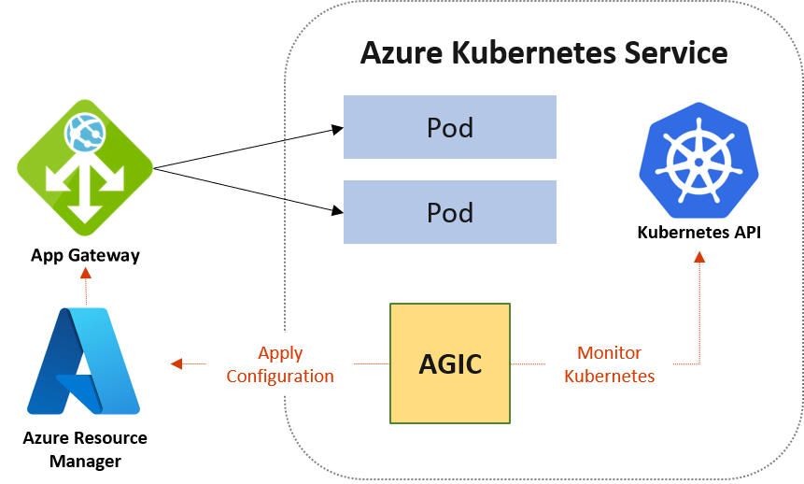
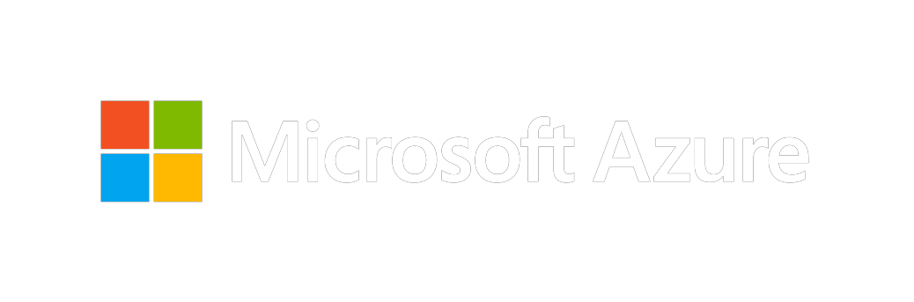
Application Gateway + Ingress Controller (AGIC)
Public / Private regional load balancing
URL routing
Cookie-based affinity
TLS termination
End-to-end TLS
Support for public, private, and hybrid web sites
Integrated web application firewall

Slide 4
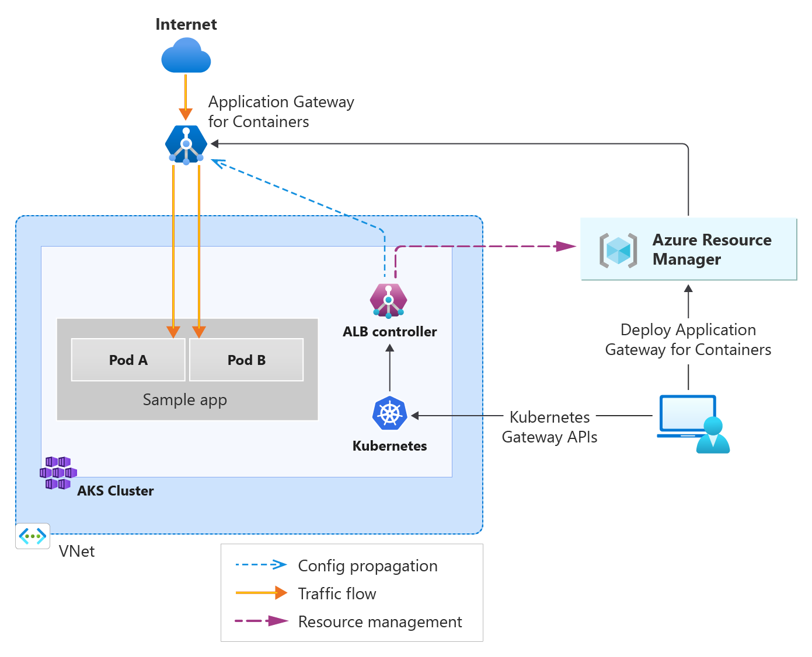
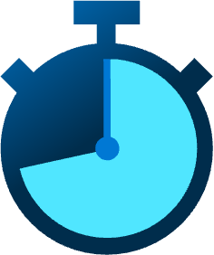





Application Gateway for Containers (AGC)
Generally Available
Managed Application Load Balancer for Kubernetes
Near real-time configuration updates
External to cluster – offload network compute
Deploy via ARM, Bicep, PowerShell, CLI, Terraform, Gateway API, and Ingress API
TLS offloading, ECDSA+RSA certificate support, and Frontend/Backend Mutual Authentication
Manage resource lifecycle via Kubernetes or Azure
URL / Header Redirect, Rewrite, and Routing
Monitor & Troubleshoot via Azure Monitor, Prometheus, local backend health, and resource status
Weigh traffic for blue/green deployments
HTTP/S, Server-Sent Events, WebSocket, gRPC

Slide 5
Current state (AGIC) | Successor (AGC)

Slide 6
Application Gateway for Containers (AGC)
Components of AGC
Azure Resource Manager
AGC
Frontend
Association
Kubernetes
ALB Controller

Slide 7
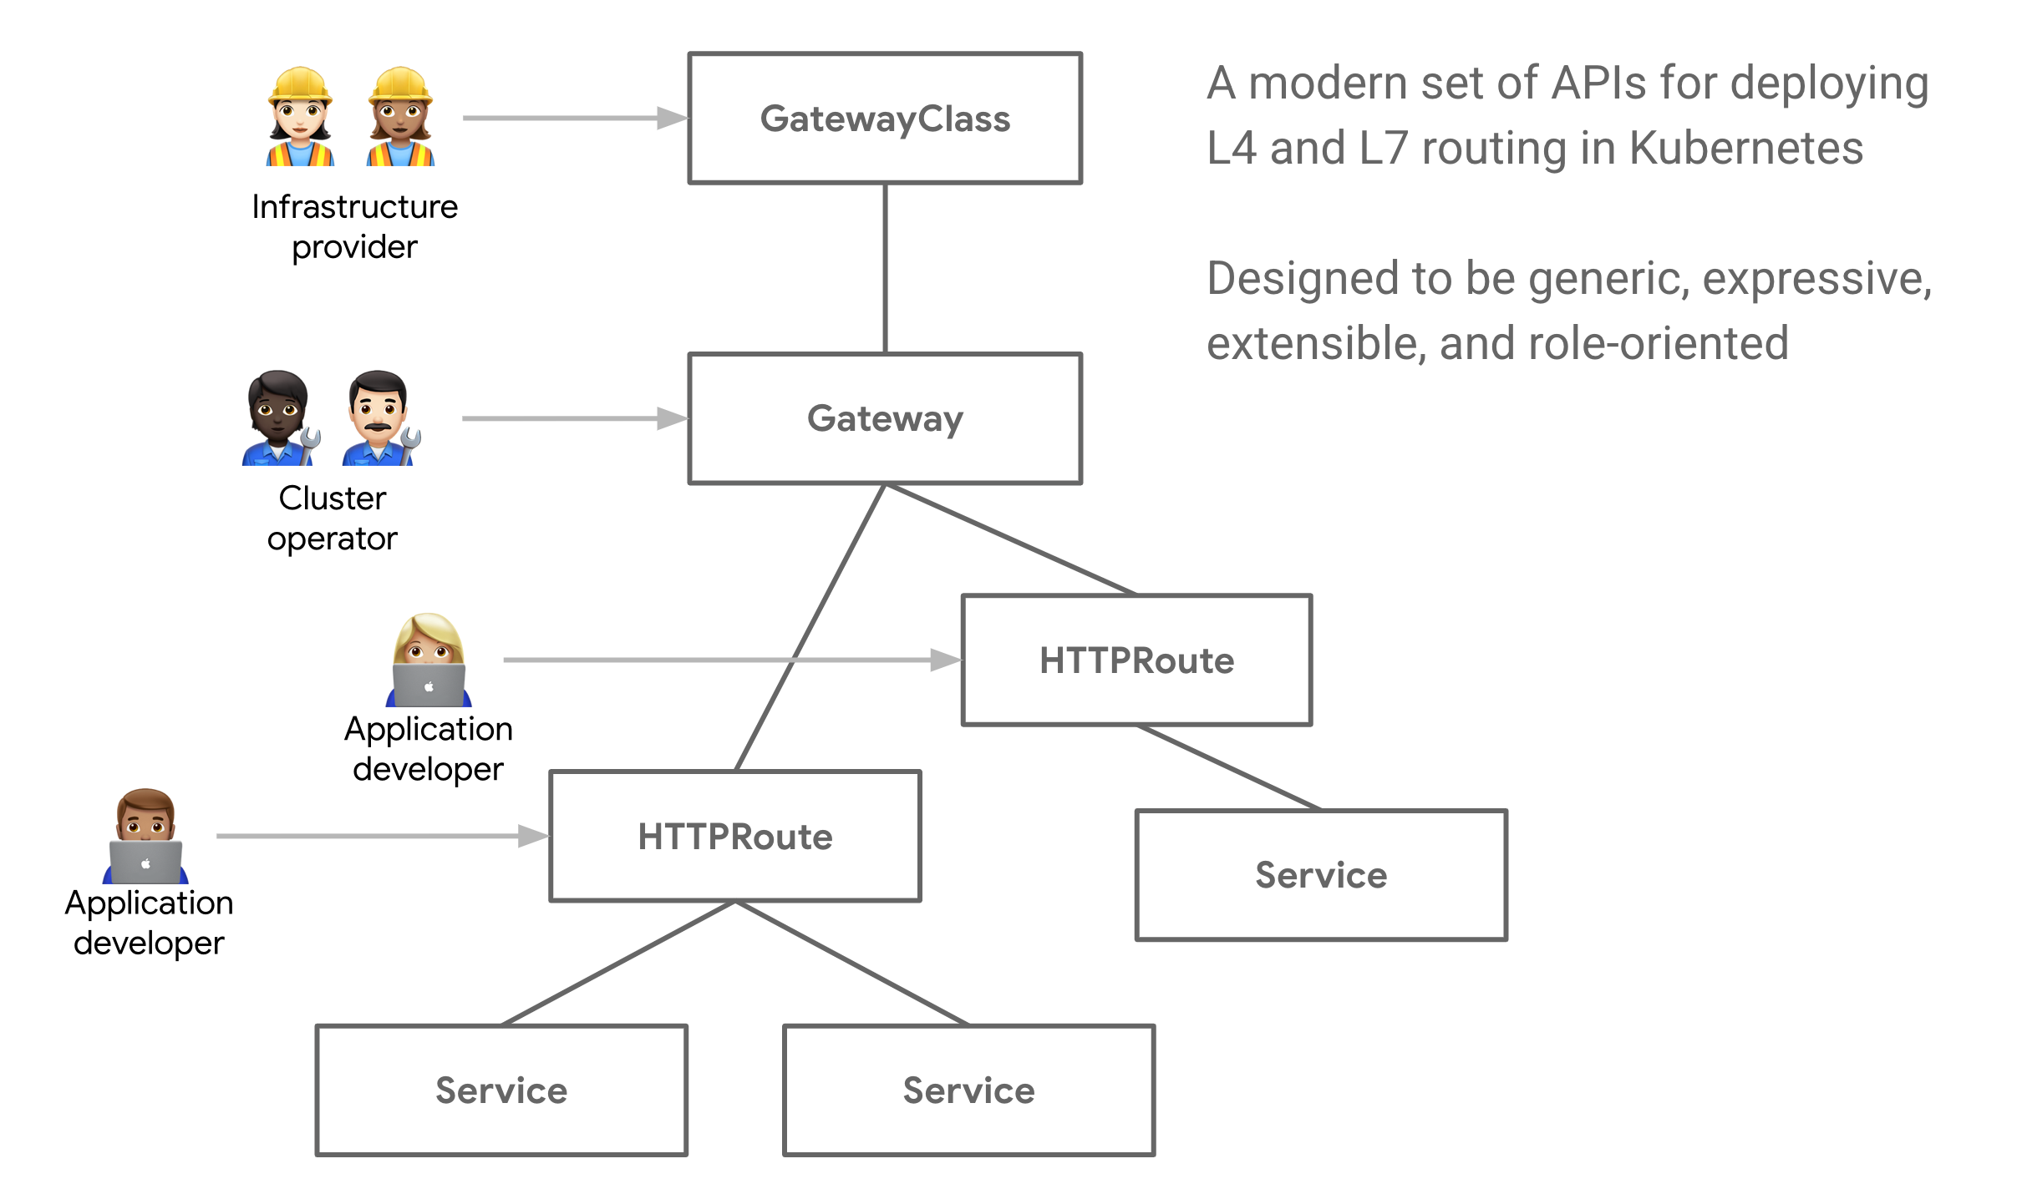
Gateway API
Gateway Resource
apiVersion: gateway.networking.k8s.io/v1beta1
kind: Gateway
metadata:
name: gateway-01
namespace: test-infra
annotations:
alb.networking.azure.io/alb-namespace: alb-test-infra
alb.networking.azure.io/alb-name: alb-test
spec:
gatewayClassName: azure-alb-external
listeners:
- name: http-listener
port: 80
protocol: HTTP
allowedRoutes:
namespaces:
from: Same
HTTPRoute resource
apiVersion: gateway.networking.k8s.io/v1beta1
kind: HTTPRoute
metadata:
name: rewrite-example
namespace: test-infra
spec:
parentRefs:
- name: gateway-01
hostnames:
- "contoso.com"
rules:
- matches:
- path:
type: PathPrefix
value: /shop
filters:
- type: URLRewrite
urlRewrite:
path:
type: ReplacePrefixMatch
replacePrefixMatch: /ecommerce
backendRefs:
- name: backend-v1
port: 8080
- backendRefs:
- name: backend-v2
port: 8080
Introduction - Kubernetes Gateway API (k8s.io)

Slide 8
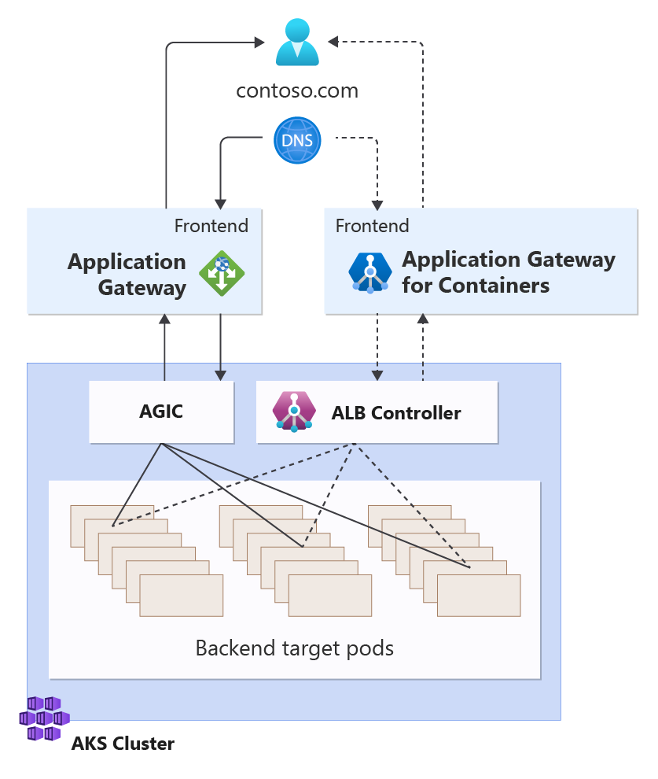
Migration to Application Gateway for Containers
Parallel migration
Enable an incremental migration approach
Allow for end-to-end validation prior to migration
Ensure no downtime

Slide 9
Features

Slide 10
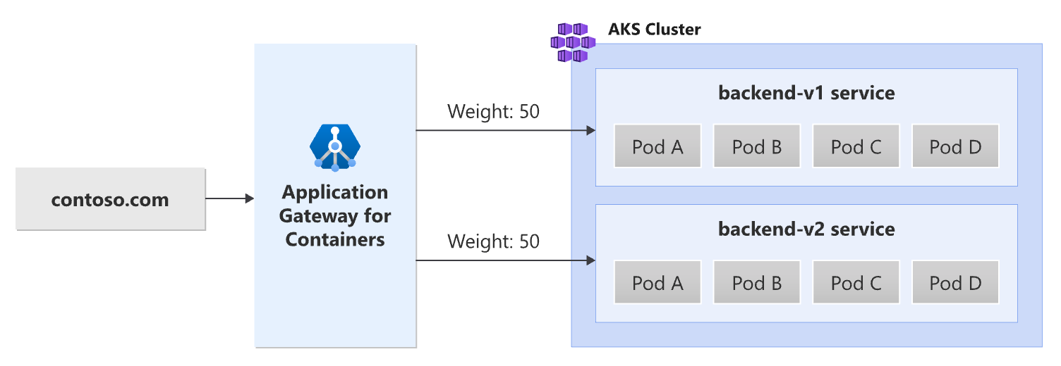
Traffic Splitting / Weighted Round Robin
Weights can be added per service
Excellent for blue/green deployments
Traffic Splitting with Application Gateway for Containers - Gateway API | Microsoft Learn

Slide 11
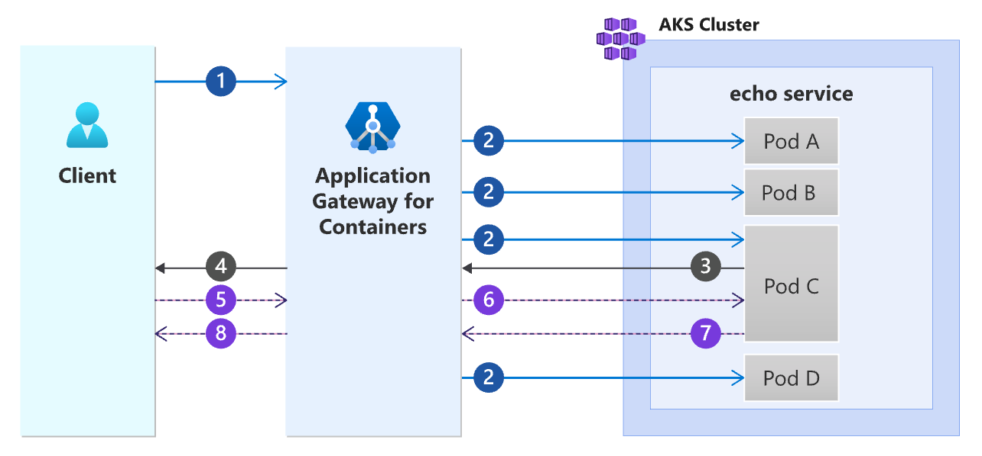
Session Affinity
Establish connections to a previously connected backend
The following steps are depicted in the previous diagram:
A client initiates a request to an Application Gateway for Containers' (Application Gateway for Containers) frontend.
Application Gateway for Containers selects one of the many available pods to load balance the request to. In this example, we assume Pod C is selected out of the four available pods.
Pod C returns a response to Application Gateway for Containers.
In addition to the backend response from Pod C, Application Gateway for Containers adds a Set-Cookie header containing a uniquely generated hash used for routing.
The client sends another request to Application Gateway for Containers along with the session affinity cookie set in the previous step.
Application Gateway for Containers detects the cookie and selects Pod C to serve the request.
Pod C responds to Application Gateway for Containers.
Application Gateway for Containers returns the response to the client
Session affinity overview for Azure Application Gateway for Containers | Microsoft Learn

Slide 12
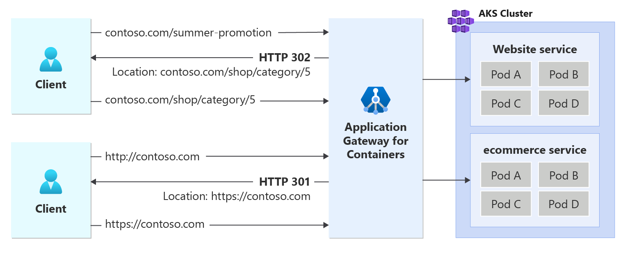
Redirect Support
Redirect based on protocol, host, or path
URL Redirect for Azure Application Gateway for Containers - Gateway API | Microsoft Learn

Slide 13
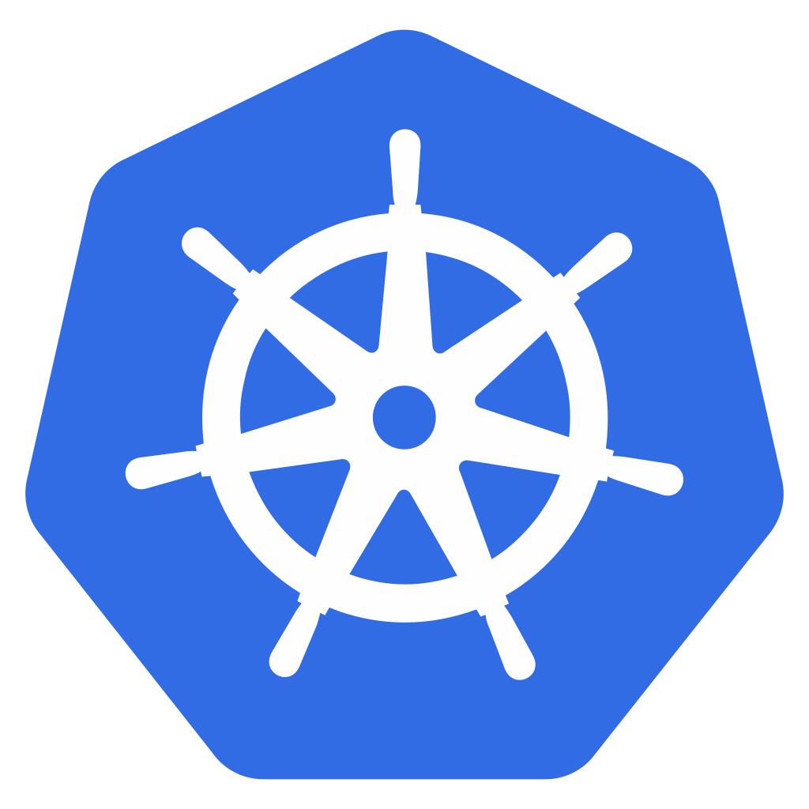

Slow Start
Normal Distribution
Slow Start
RPS
RPS
Application Gateway for Containers
Time
Time
Configure ramp up of traffic to new pods of a service
Control window (duration of slow start), aggression factor, and starting weight
AKS Cluster
Pod 1
Pod 2
Pod 3

Slide 14
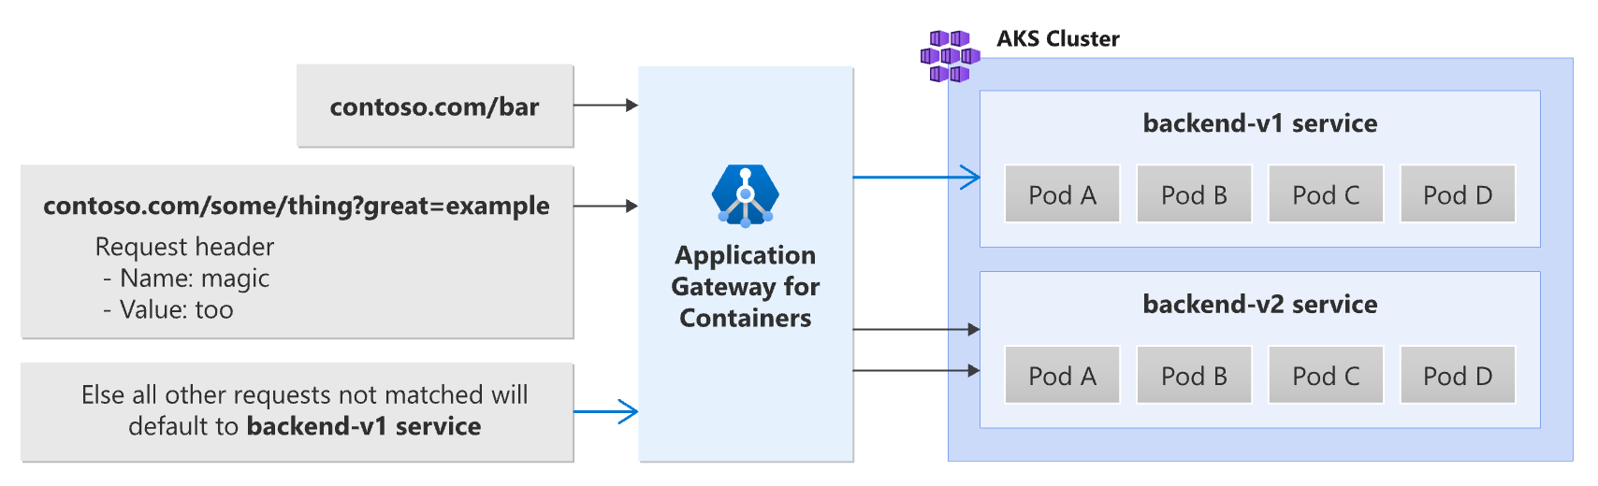
Path, Header, and Query String Routing
Route requests by:
Path
Query String
Header Value
Path, header, and query string routing with Application Gateway for Containers - Gateway API | Microsoft Learn

Slide 15
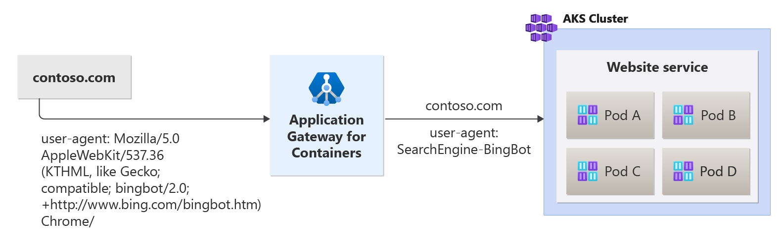
Header Rewrite
Adjust request and response headers
Header rewrite for Azure Application Gateway for Containers - Gateway API | Microsoft Learn

Slide 16
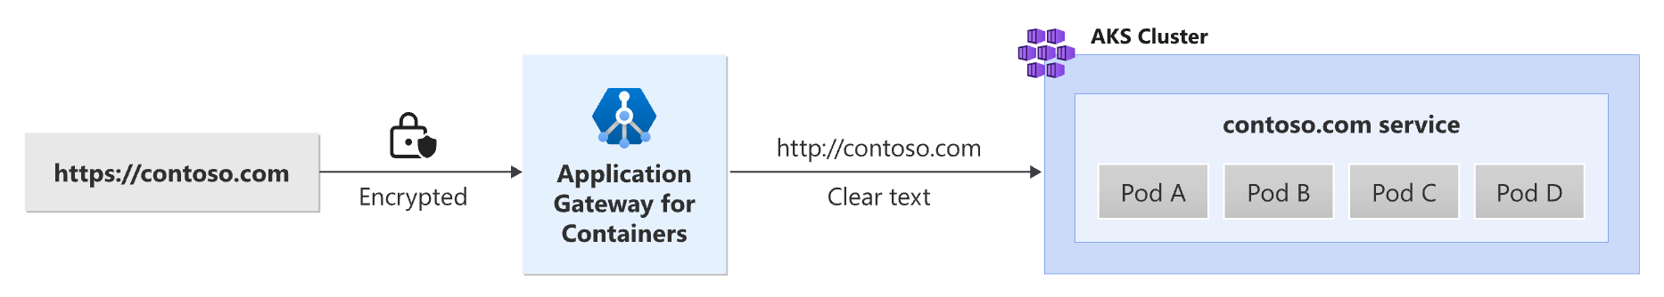
TLS (SSL) Offloading
Offload TLS termination to AGC
SSL offloading with Application Gateway for Containers - Gateway API | Microsoft Learn

Slide 17
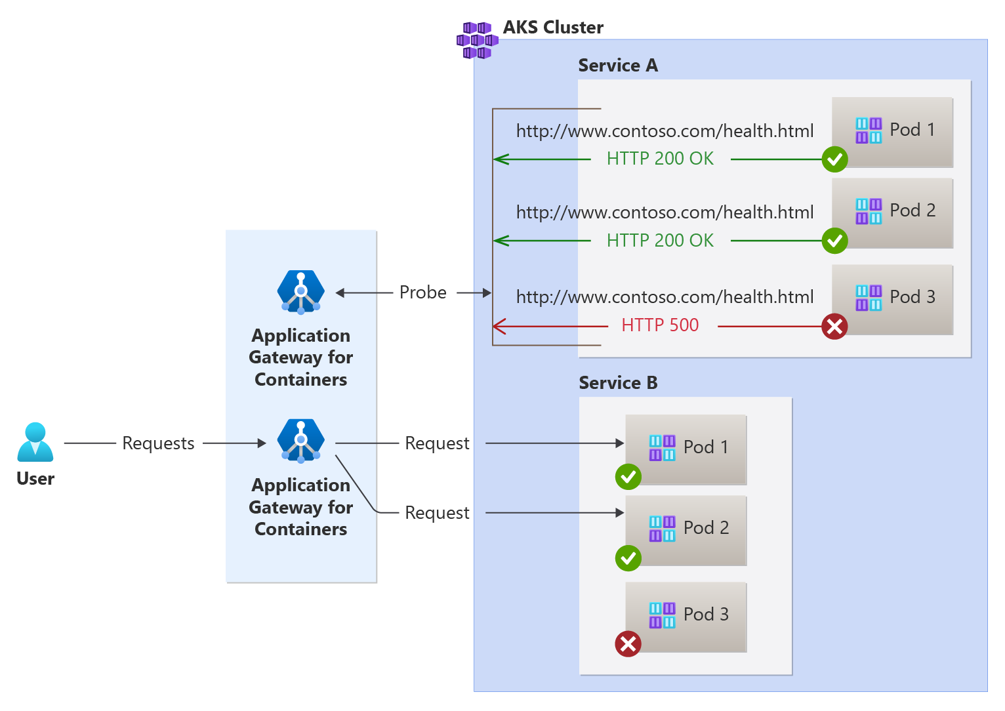
Custom Health Probes
Determine health based on a defined set of criteria
Custom health probe for Azure Application Gateway for Containers | Microsoft Learn

Slide 18
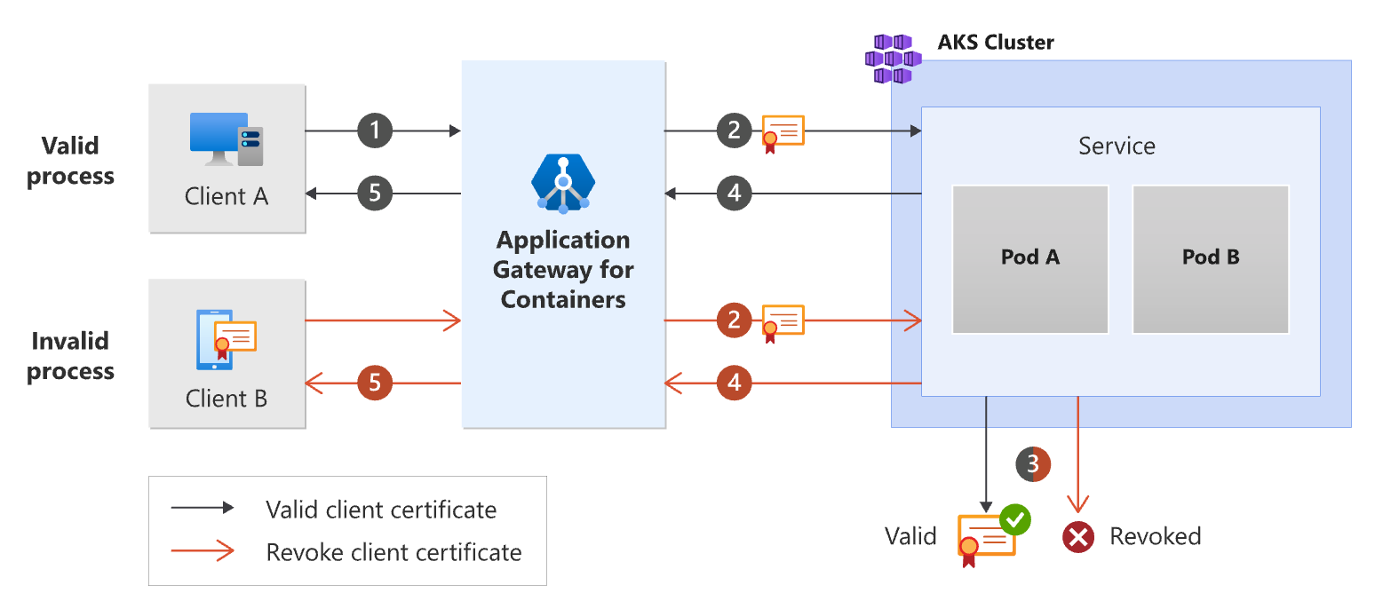
Backend Mutual Authentication
Authenticate to backend targets via client certificate
Backend MTLS with Application Gateway for Containers - Gateway API | Microsoft Learn

Slide 19
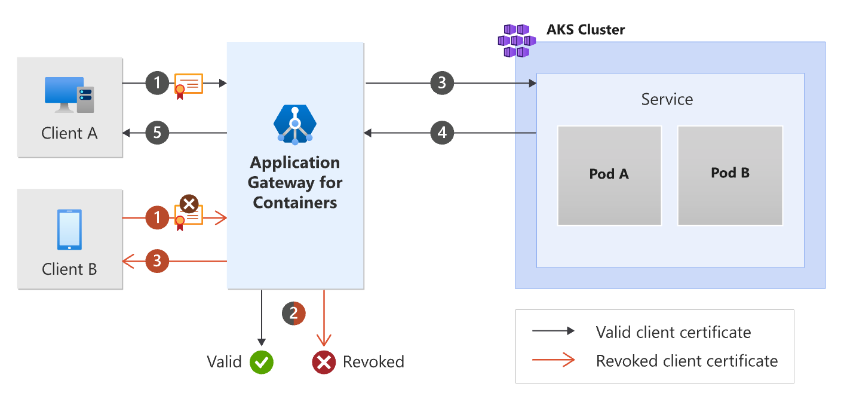
Frontend Mutual Authentication
Authenticate clients via a certificate
Backend MTLS with Application Gateway for Containers - Gateway API | Microsoft Learn

Slide 20
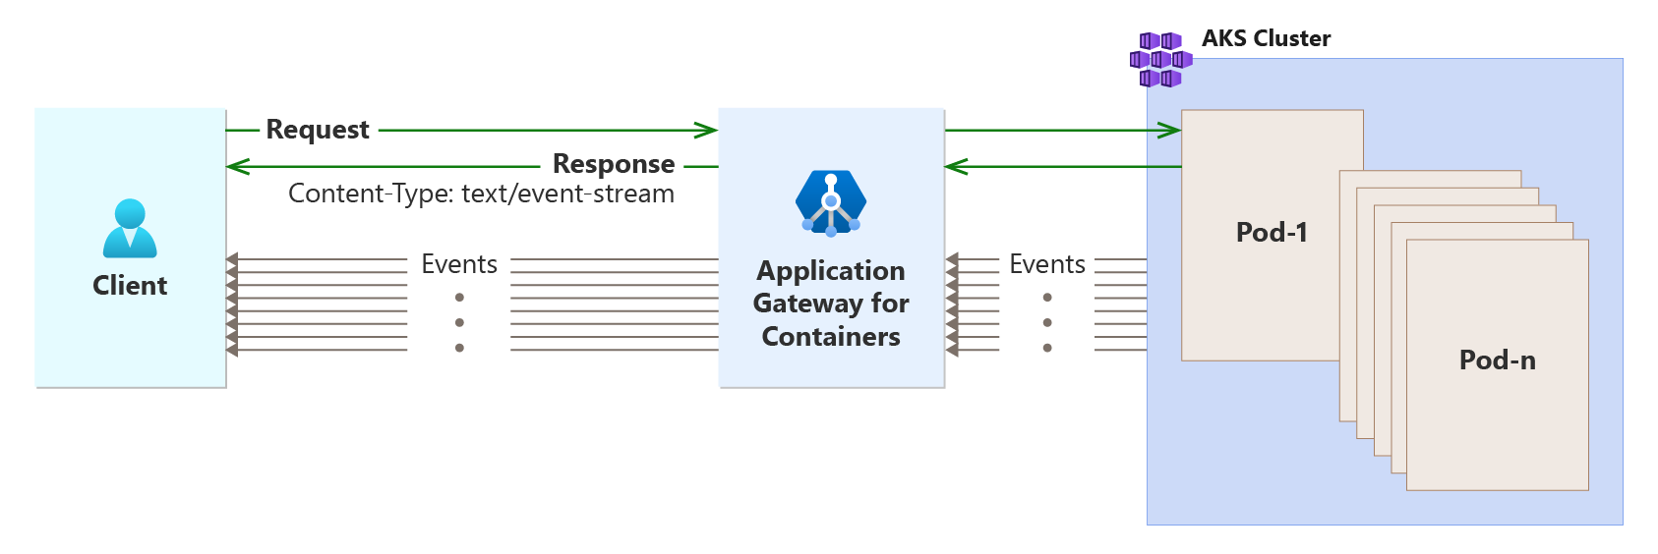
Server-sent events (SSE)
Enable servers to push real-time updates to web clients over a single HTTP connection
Server-sent events and Application Gateway for Containers | Microsoft Learn

Slide 21
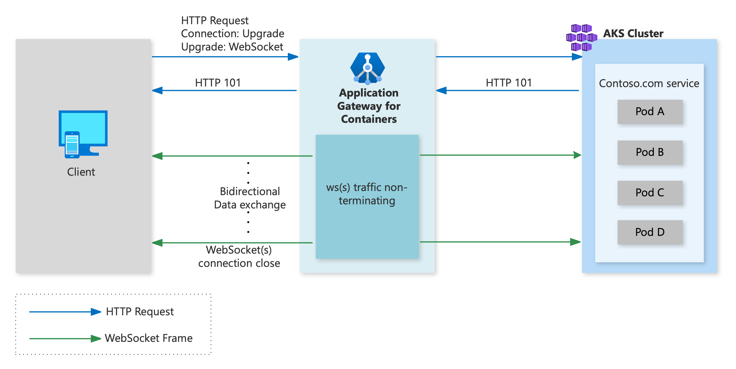
WebSocket Protocol
Established in RFC6455, enable two-way communication between a client and server
Browser compatibility: Nearly all modern web browsers support WebSockets.
Real-time data: WebSockets enable real-time data transfer between client and server.
Efficiency: WebSockets eliminate the need to continuously poll servers to check for updates.
Security: WebSockets can be encrypted using TLS and use standard HTTP ports, such as 80 and 443.
Flexibility: WebSockets can be used for a variety of applications, including chat, gaming, and financial trading platforms.
WebSocket protocol and Application Gateway for Containers | Microsoft Learn

Slide 22
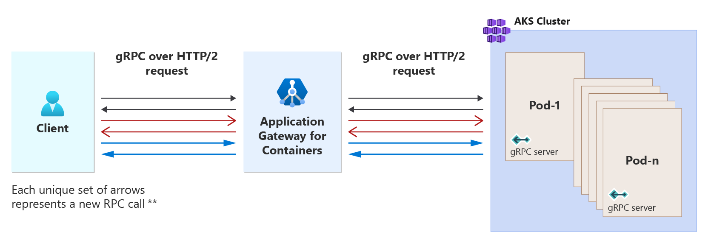
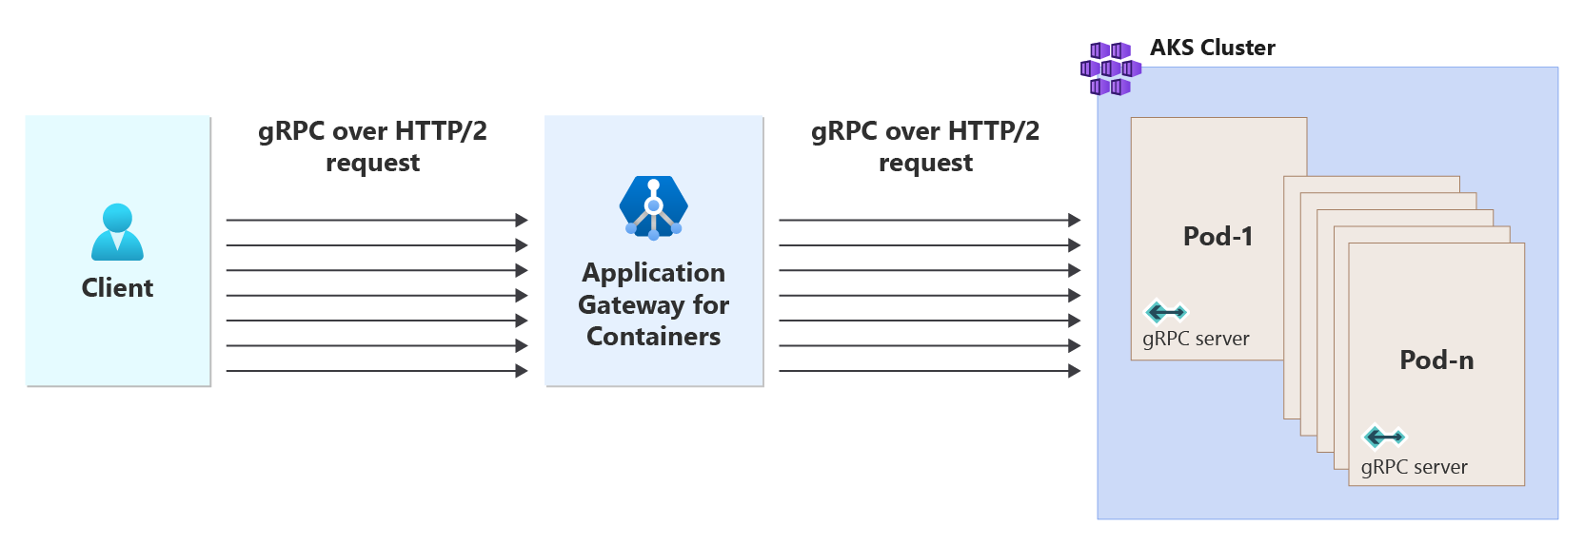
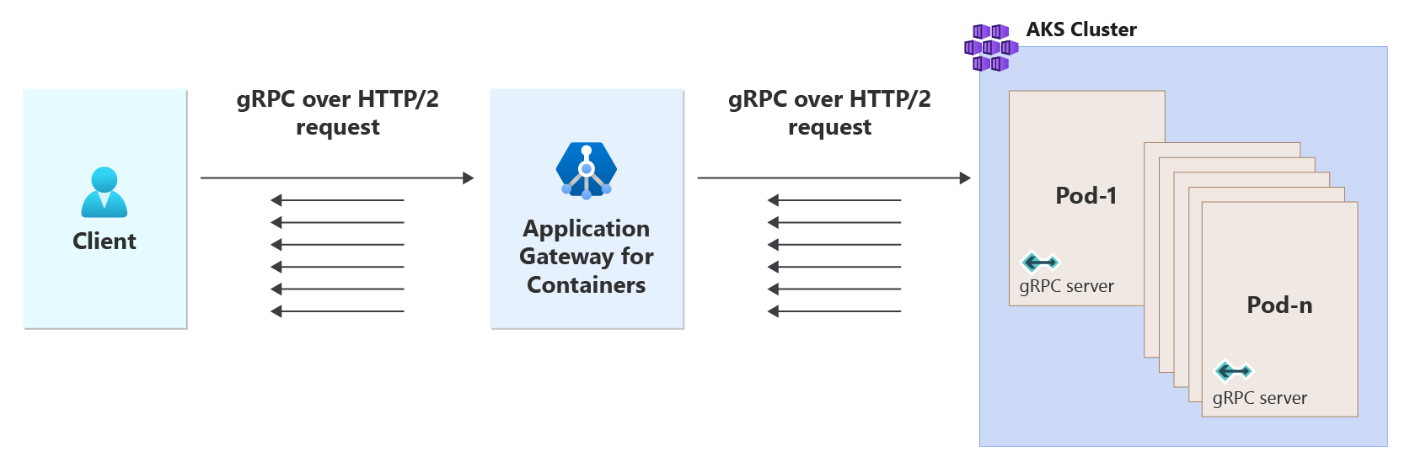
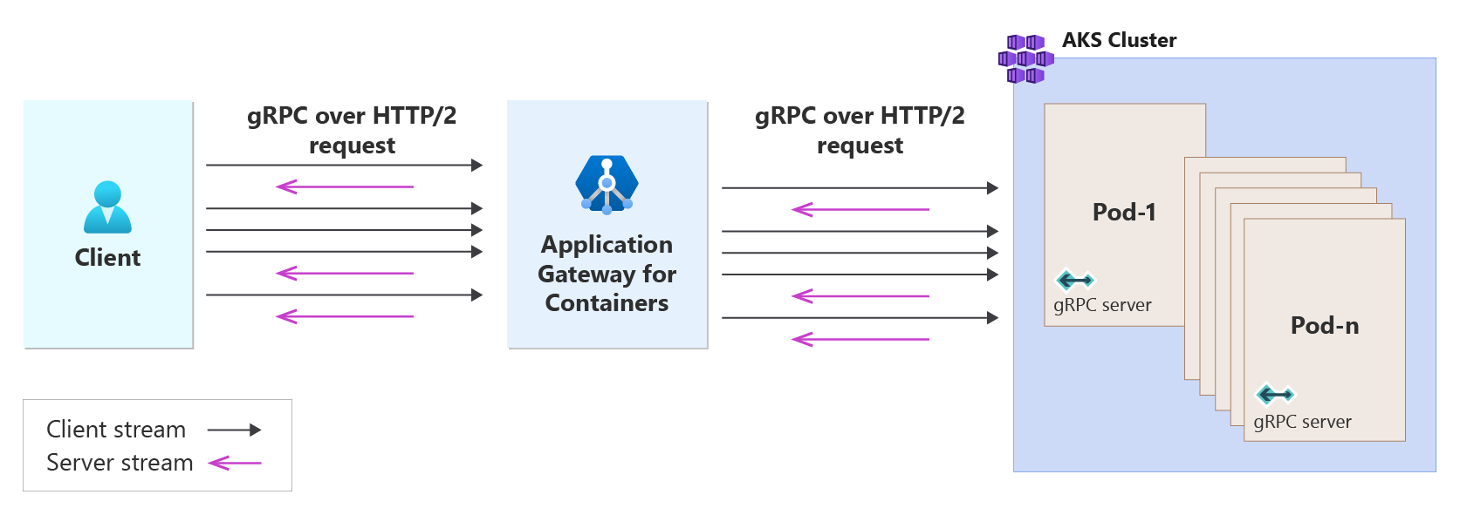
gRPC
Unary RPC
gRPC is lightweight and highly performant protocol; up to 8x faster than JSON serialization with messages 60-80% smaller.
Support for all four life cycles:
Unary
Client-Streaming
Server-Streaming
Bidirectional-Streaming
Client Streaming RPC
Server Streaming RPC
Bidirectional RPC
gRPC with Application Gateway for Containers | Microsoft Learn
22

Slide 23
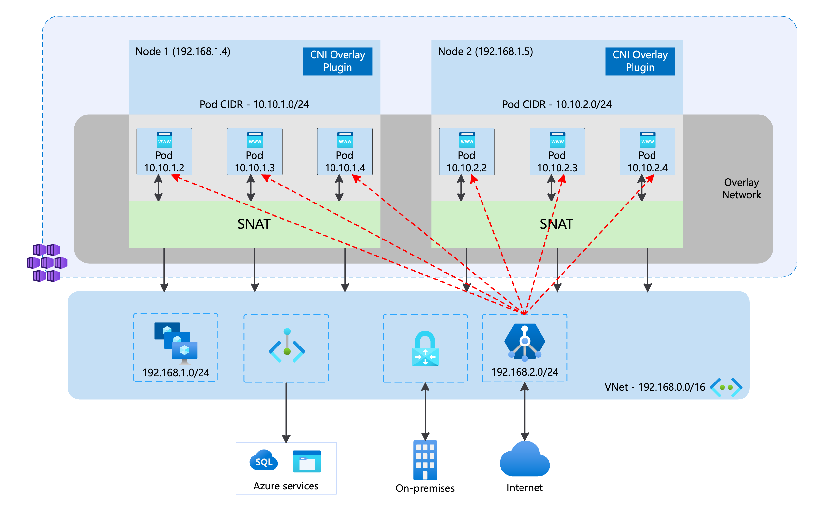
CNI + CNI Overlay
Conserve IP allocations in your Azure Virtual Network with CNI Overlay!
Support for CNI and CNI Overlay
Support for Kubernetes Network Policies
Azure Network Policies, Cilium, Calico
Traffic proxied directly to pods
CNI -> CNI Overlay supported for AGIC/AGC
Kubenet -> CNI Overlay supported for AGIC
Container networking with Azure Application Gateway for Containers | Microsoft Learn

Slide 24
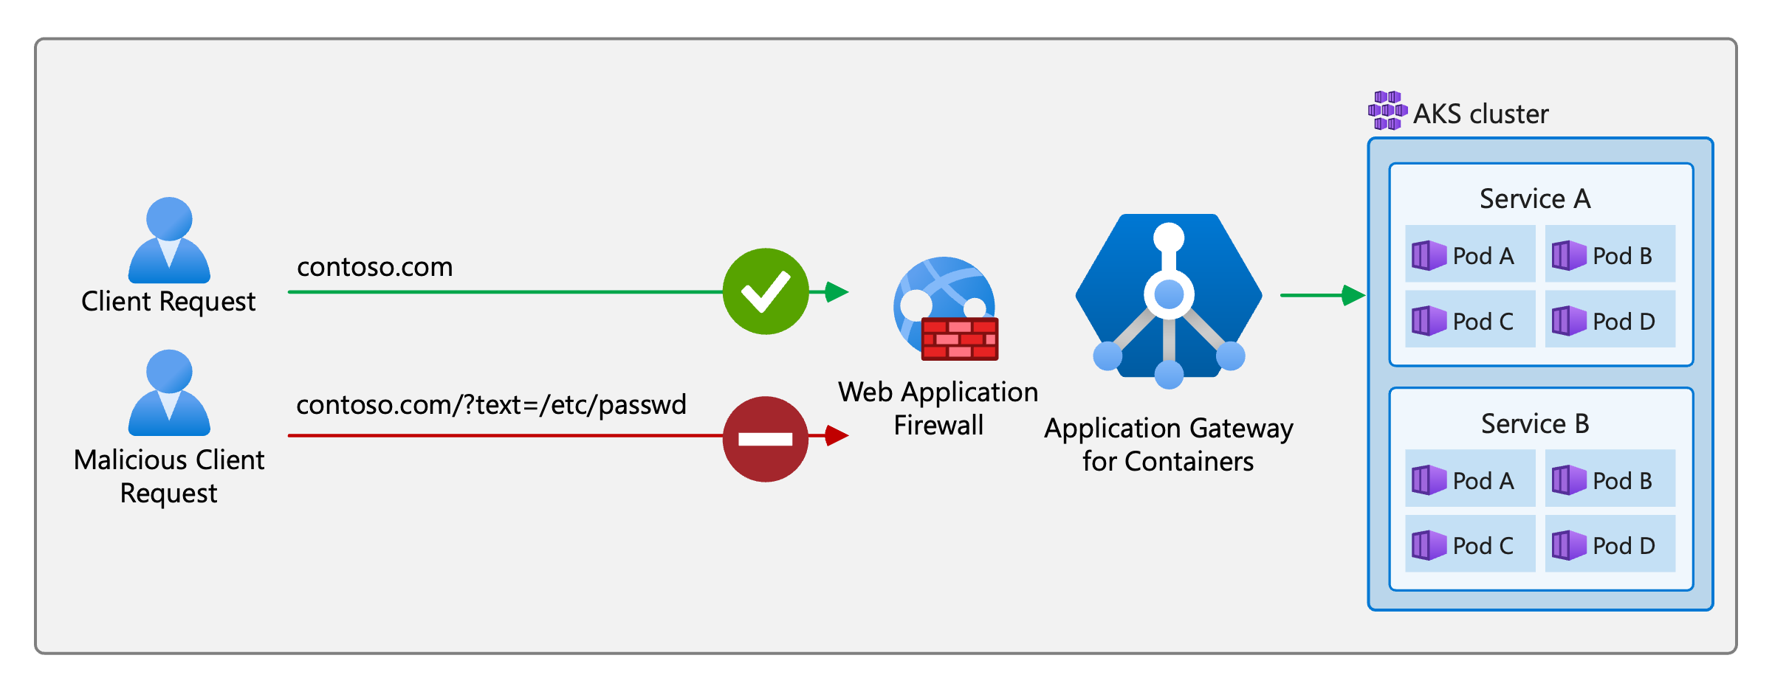
Web Application Firewall
Leverage Web Application Firewall Policy with Application Gateway for Containers!
Features:
Managed & Custom Rules
DRS 2.1 ruleset
Geomatch rules
Bot protection
Scoped assignment
Gateway
Listener
HTTPRoute
Path
Web Application Firewall on Application Gateway for Containers | Microsoft Learn

Slide 25
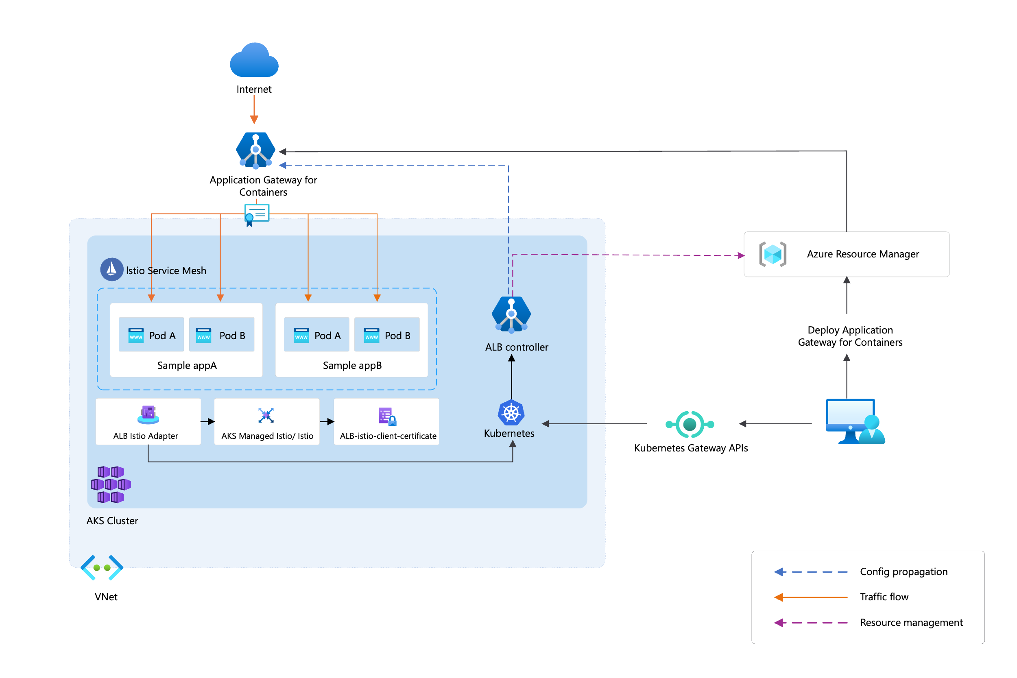
Integration - Istio Mesh (Preview)
Seamless ingress to mesh:
Automatic certificate management; issuance and rotation
Encrypted traffic using mTLS between AGC and service mesh pods
Deployed in HA configuration
Optional installation for those that don’t use Istio

Slide 26
Previews / Roadmap

Slide 27
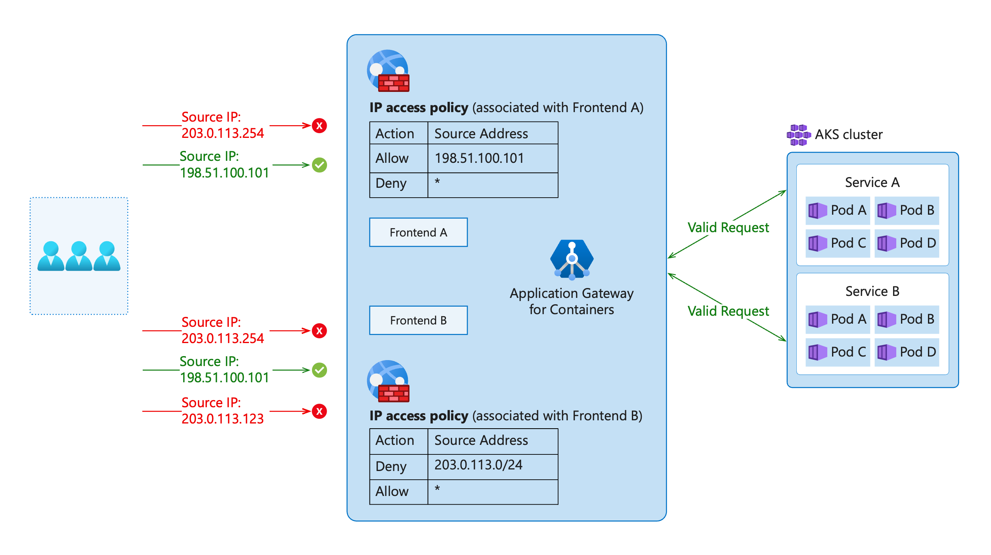
IP Access Policy (Private Preview)
IP Access Policy
Rules supported:
Individual IP addresses
(e.g., 198.51.100.101)
IP prefixes in CIDR notation
(e.g., 198.51.100.0/24)
Wildcard * to match all IPs
Scoped to Frontend resource
Up to 100 rules per policy

Slide 28
Application Gateway for Containers: Add-on
Public Preview
Click-deploy installation of ALB Controller
Cluster managed updates for ALB controller
Leverages managed AKS Gateway API add-on
Add-on

Slide 29
Application Gateway for Containers: Load Aware Routing
Public Preview
Distribute traffic to backend pods based on metrics
Implements Open Request Cost Aggregation (ORCA) load report format
Optimize traffic distribution based on a defined metric, such as CPU, Memory, GPU, etc.
Pod A
Pod B
Pod C
0% GPU utilization
50% GPU utilization

Slide 30
Workshop

Slide 31
Bootstrap the environment
The workshop Git repository is in the following link: AGC Workshop
Make sure you follow the the Readme file and preforming the instructions to create the workshop environment.
View the resources created in your Azure tenant.

Slide 32
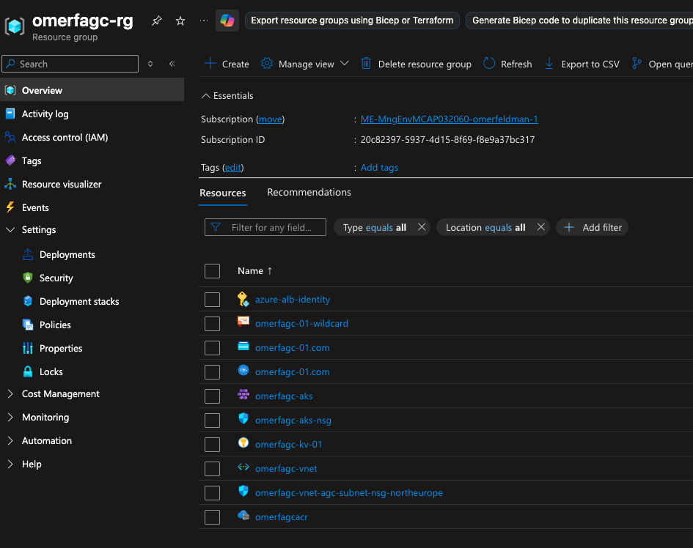
Get to know the environment
Once everything has been created, you will have a running AKS cluster with two applications running (app1 & app2) which are a basic web server.
All the infrastructure + app related resources relevant for this workshop will be inside the created resource group. During the workshop we will demonstrate & practice how to utilize Application Gateway for Containers (AGC) features to accommodate Gateway needs in a modern environment. After you have reviewed the resources, connect to the created AKS resource (steps can be found in the connect button inside the AKS page)

Slide 33
Get to know the environment
In addition, All the components needed for Application Gateway for Containers are exists.
There is a Gateway resource (named “app-gateway”) which includes two listeners (http-listener, https-listener) to fulfil the workshop needs, all the resources that will be created in this workshop should be inside the namespace called app-networking

Slide 34
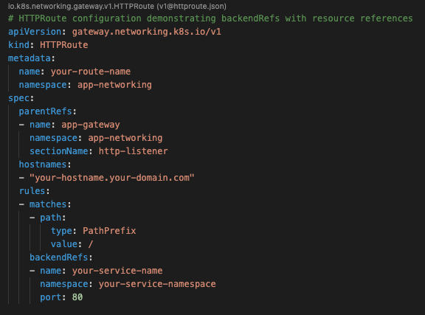
Step 1 – FQDN route
As mentioned, there are two running applications (app1 & app2) which runs inside namespaces called app1, app2 and each referenced by a ClusterIP service (app1, app2).
In this first step we will create FQDN based HTTPRoute resource for each workload to allow ingress traffic for HTTP from outside of the cluster. Attached is a template of the HTTPRoute CR.
Replace the values to the values you think that should match, use the values of app1 & app2 for the your-hostname value.
After you have deployed, try to access the FQDNs described in the yaml file in http.

Slide 35
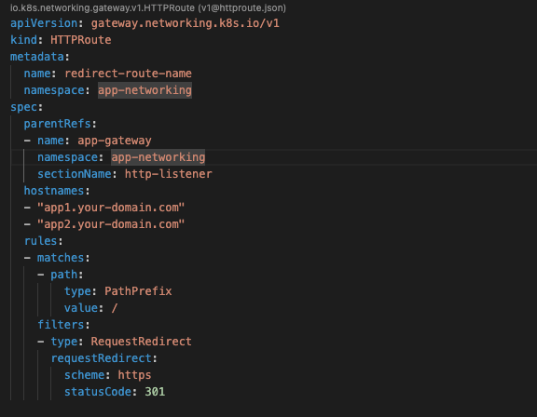
Step 2 – Redirect route
Now that our apps is accessible through http, let modify them to use https, this can be done by changing the listener to the https-listener.
To make sure that clients will approach the apps in HTTPS only, we will need to create a redirect route to modify http traffic to https.
Attached is a redirect policy template.
After applying the changes try to access the apps in HTTPS & HTTP.

Slide 36
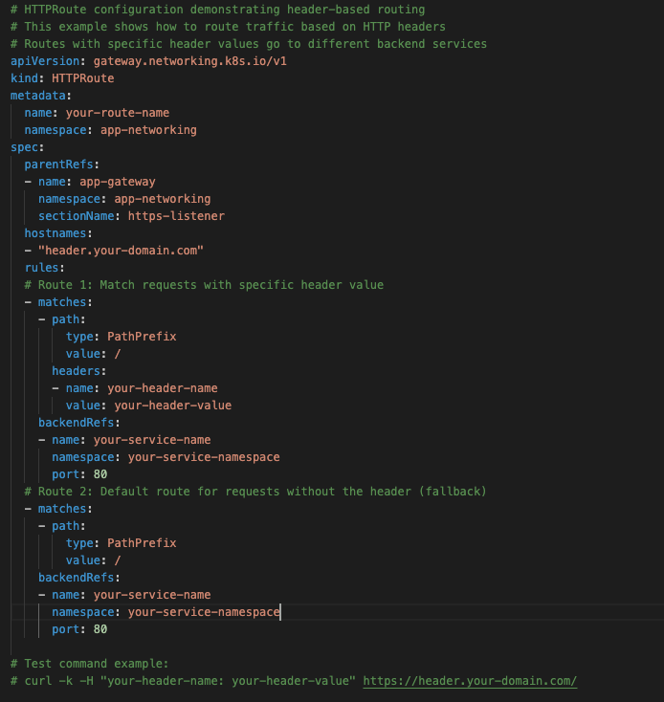
Step 3 – Header route
In some cases, we would like to route clients to different apps based on some information from the clients. One of the cases can be a header passed in the request.
Create an HTTPRoute to handle the following case: if a header named “X-Version” has the value of “beta”, the request should be routed to app2, in other cases, the request should be routed to app1. make this route accessible in the following FQDN: “header.<YOUR_DOMAIN>.com” Attached is a template for doing that. After the changes has been applied, try to access the FQDN with and without the header. It can be tested using the commands:
curl -k -s -H "X-Version: beta" https://header.your-domain.com/
curl -k -s -H "X-Version: no_beta" https://header.your-domain.com/
blala

Slide 37
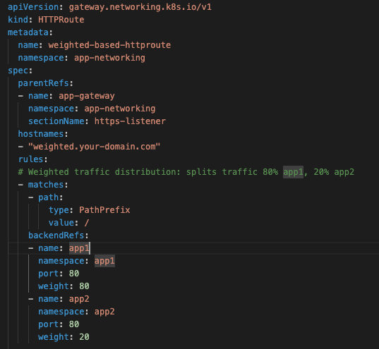
Step 4 – Weighted route
Additional option to configure clients route behaviour is based on weights, X amount of traffic will go to certain app and Y amount will go to another.
Let's create a weighted route another the FQDN of weighted.<YOUR_DOMAIN>.com and route 80% of the traffic to app1 and the remaining 20% to app2.
Attached is a template for weighted route
This can be tested using the following command:
count_app1=0; count_app2=0; for i in $(seq 1 100); do response=$(curl -k -s https://weighted.your-domain.com/); if [[ $response == *"app1"* ]]; then ((count_app1++)); else ((count_app2++)); fi; done; echo "=== Weighted distribution results (100 requests) ==="; echo "app1: $count_app1 requests ($(( count_app1 ))%) should be approximately 80%"; echo "app2: $count_app2 requests ($(( count_app2 ))%) should be approximately 20%"

Slide 38
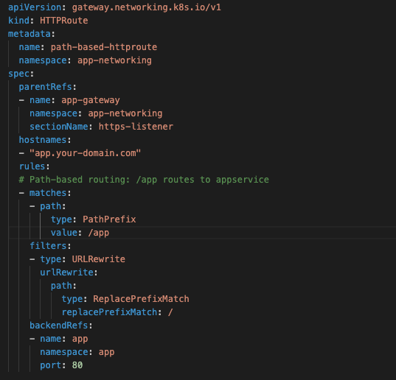
Step 5 – Path route
Another option is to serve two different apps inside the same FQDN and access them by path. Important thing to keep in mind that you will need to do a URL rewrite to adjust the entered path to the paths that the app expects to receive.
In this example we will create a route for the FQDN of app.<YOUR_DOMAIN>.com and by adding /app1 we will be routed to app1, and for /app2 we will get to app2 with adding URLRewrites
Attached is a template of achieving that.
Test the routing behaviour by adding the path suffix.

Slide 39
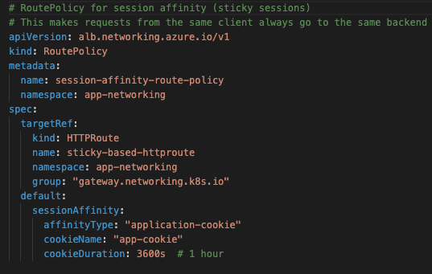
Step 6 – Session Affinity route
Session Affinity routes ensures sticky sessions across different routes behaviours, that can assure that a clients sticks to the same backend it has accessed to in the first time, this is done by cookie returned to the client which he sends in the future requests.
Let's implement a new route for the FQDN of sticky.<YOUR_DOMAIN>.com which will route between the two apps. And attach to it RoutePolicy resource which will guarantee the stickiness.
Attached is a template for the RoutePolicy.
Test the behaviour and search for the cookie returned by the Application Gateway for Containers.

Slide 40
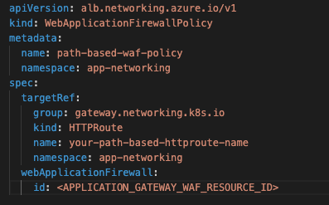
Step 7 – WAF Route
As mentioned before, Application Gateway for containers supports WAF attach for certain scopes, including Gateway, HTTPRoute, and Listener.
In this example head back to the portal, and create a WAF policy to deny traffic based on geolocation (choose your country).
We will attach this WAF to the Path based HTTPRoute that we have created in step 5. Attached is WebApplicationFirewallPolicy resource template
Test this behaviour by trying to access the same route as you did in step 5.

Slide 41
Thanks!

